Slide 1

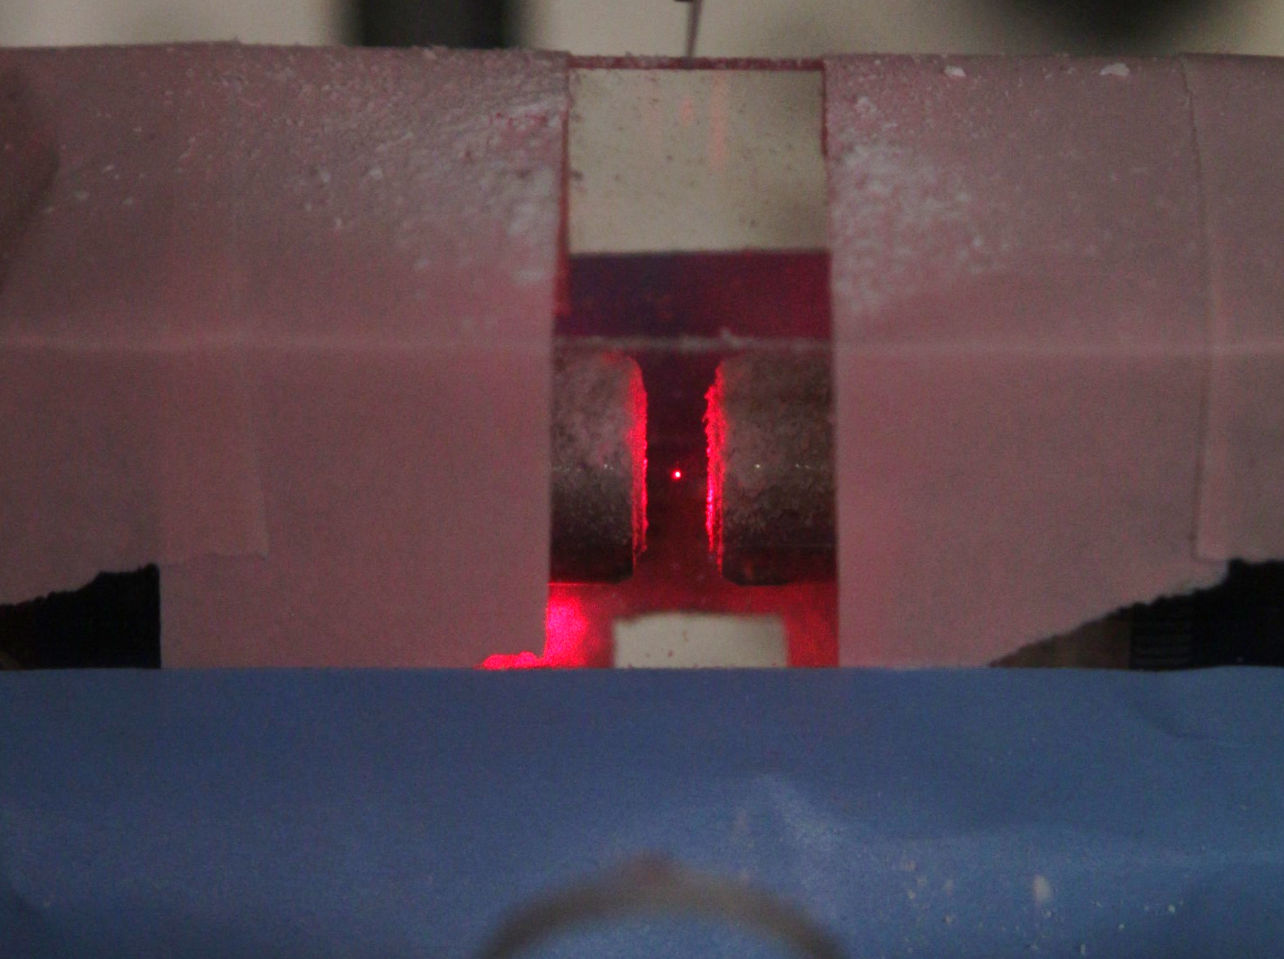
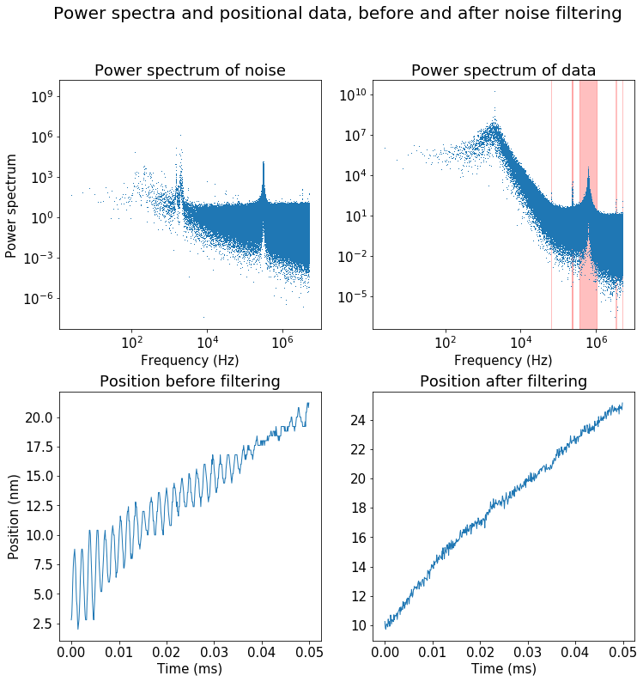
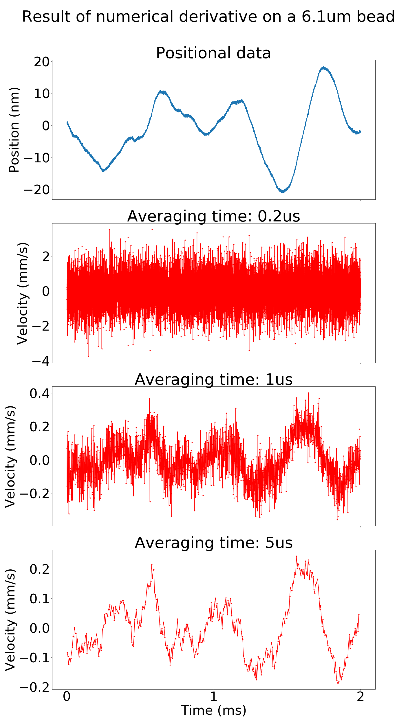
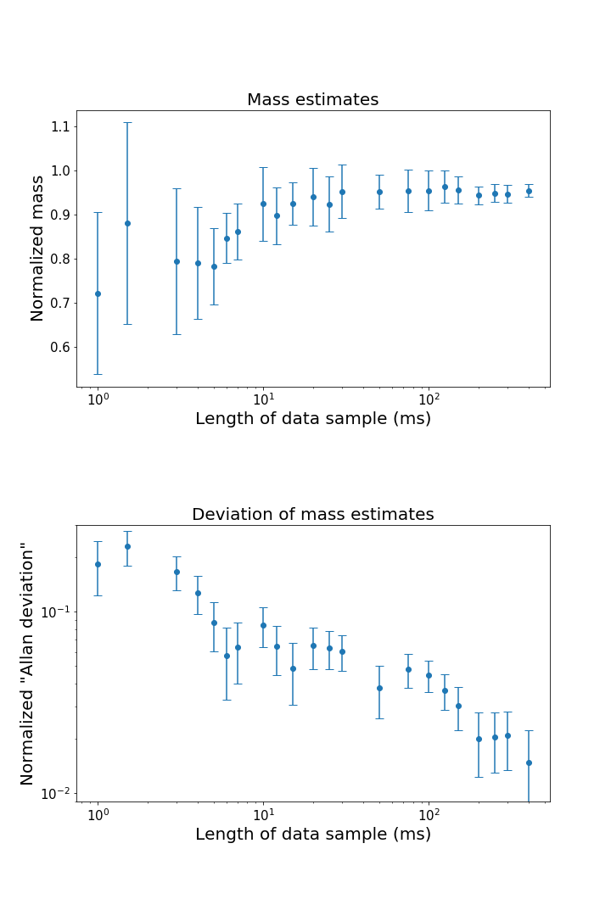
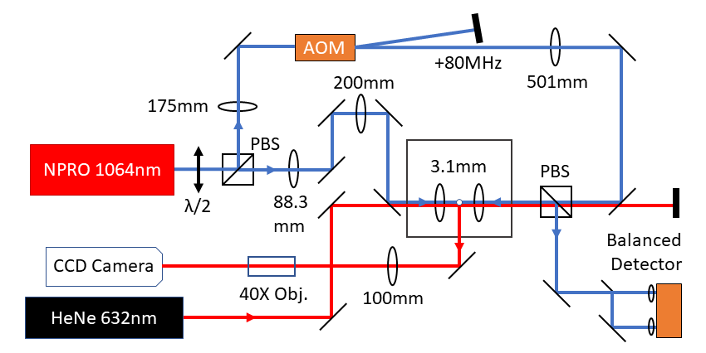
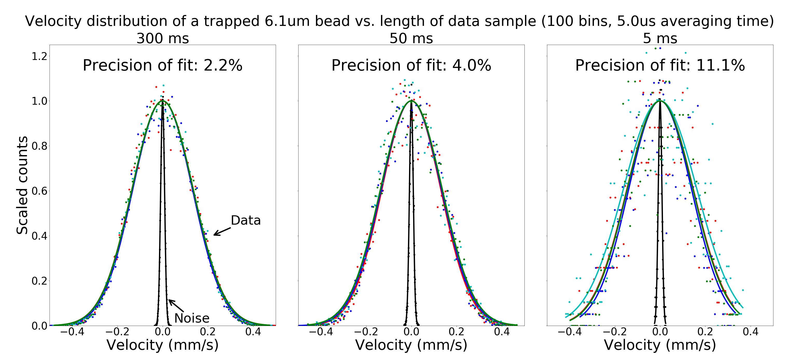
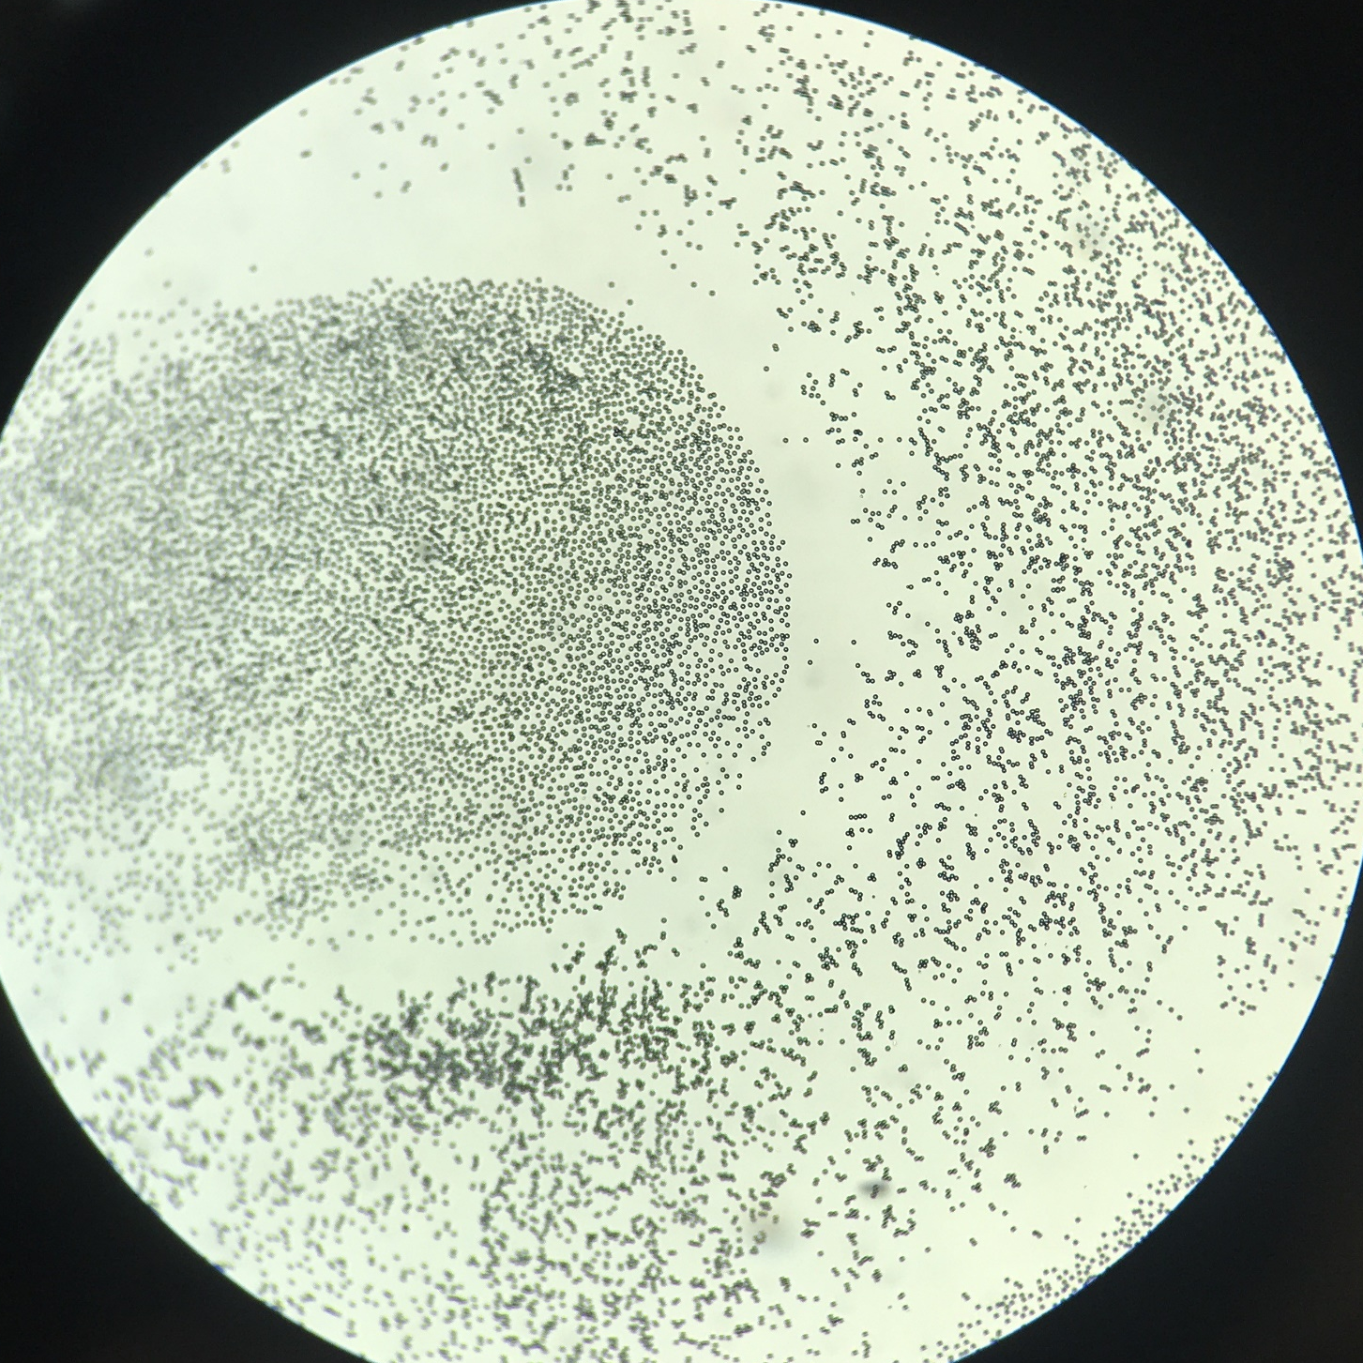

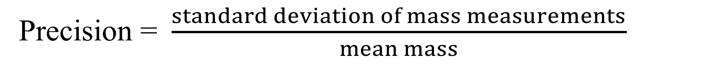
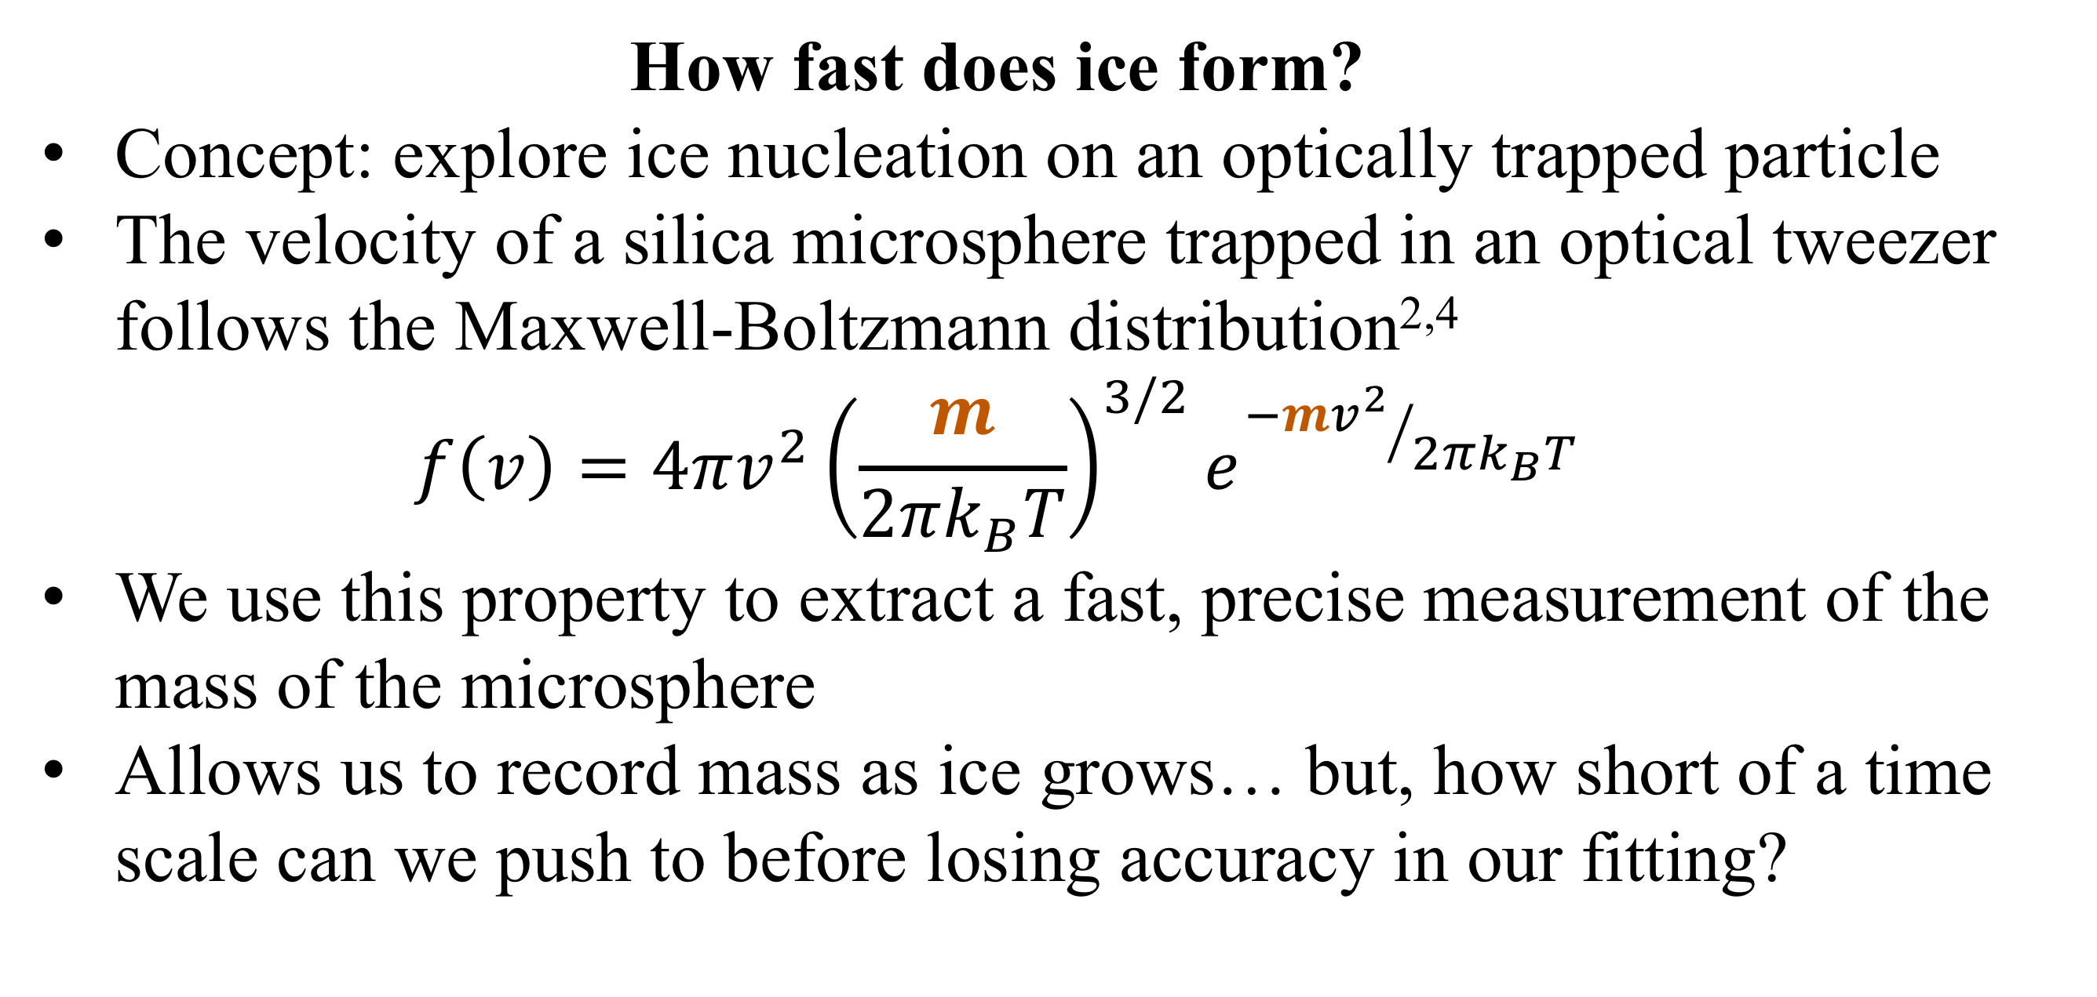
Using the instantaneous velocity of a Brownian particle in an optical tweezer to measure changes in mass
Gabriel H. Alvarez*, Julia E. Orenstein, Lichung Ha, Diney S. Ether Jr., Mark G. Raizen
University of Texas at Austin, Austin, TX (*Stanford University, Stanford, CA)
Motivation
Data and Results
Noise Canceling
How fast does ice form?
Concept: explore ice nucleation on an optically trapped particle
The velocity of a silica microsphere trapped in an optical tweezer follows the Maxwell-Boltzmann distribution^{2,4}
$$f\left(v\right)=4πv^{2}{\left(\frac{m}{2πk_{B}T}\right)}^{3/2}e^{{−mv^{2}}/{2πk_{B}T}}$$
We use this property to extract a fast, precise measurement of the mass of the microsphere
Allows us to record mass as ice grows… but, how short of a time scale can we push to before losing accuracy in our fitting?
Align beams with a 5um pinhole
We’ve trapped beads 3.17um to 6.10um in diameter
Noise presents itself at specific frequencies which can be filtered from the Fourier transform (shown in red)
Apply inverse Fourier transform after filtering out peaks – this returns cleaner positional data
1cm
Calibration factor α converts voltage data to positional data
To increase SNR, we use a moving average (shown right)
Experimental Setup
Counter-propagating dual-beam optical tweezer
Two orthogonally-polarized NIR (1064nm) beams used for trapping
One beam is shifted 80MHz to avoid a standing wave in trap
Weak red (632nm) laser used for illumination
One trapping beam split by sharp mirror, used for detection
Balanced photodetector measures displacements of bead in 1D
CCD camera monitors light scattered by bead
Towards Observing Ice Nucleation
We can now take mass measurements in quick succession to observe a particle’s mass as it changes over time
The silica particle will act as a nucleation point, onto which we will blow cold humid air
Preliminary plans to supplement M-B fitting with measurement of Mie scattering from trapped sphere to estimate size of particle
New analytical tool that will finally enable the fundamental study of ice nucleation
wide-ranging practical applications in cloud seeding, atmospheric science
Precision = $\frac{standard deviation of mass measurements}{mean mass}$
Silica microspheres (shown below) applied to glass coverslip with Q-tip, launched from ultrasonic piezoelectric shaker into tweezer
A
References
A
T. Li et al., Measurement of the instantaneous velocity of a Brownian particle. Science 328, 1673 (2010).
T. Li, Ph.D. thesis, University of Texas at Austin, 2011.
S. Kheifets et al., Observation of Brownian Motion in Liquids at Short Times: Instantaneous Velocity and Memory Loss. Science 343, 1493 (2014).
J. Mo et al., Testing the Maxwell-Boltzmann distribution using Brownian particles. Optics Express 23(2), 1888 (2015).
B
100um

